Slide 1
Model Analysis
Honson Tran

Slide 2
Catheter Detection

Slide 3
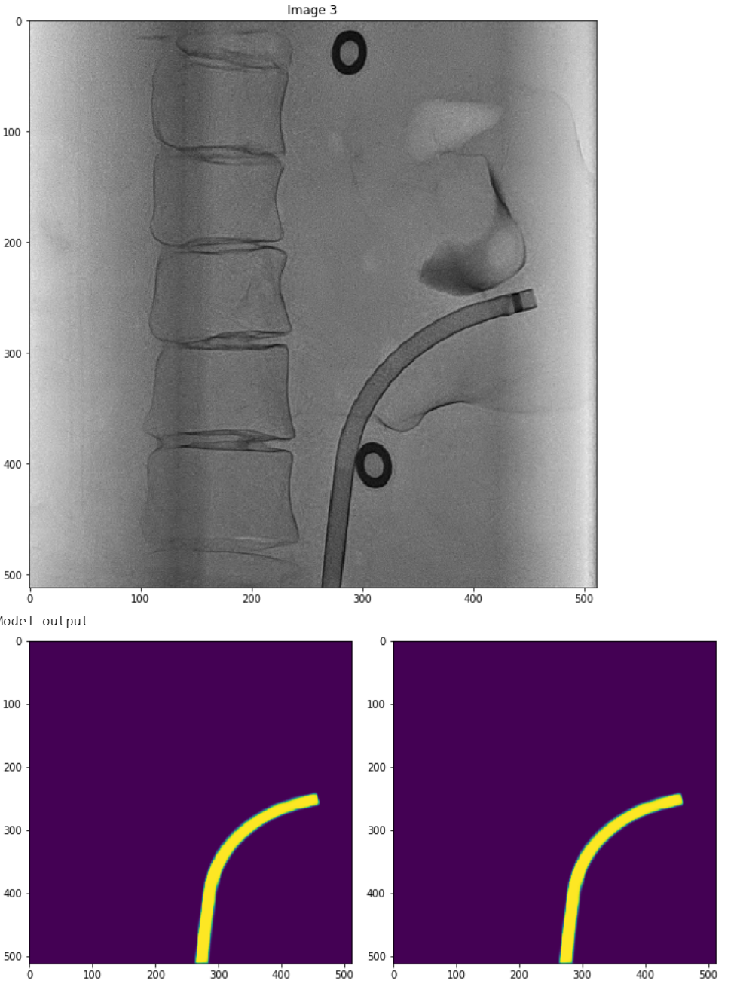
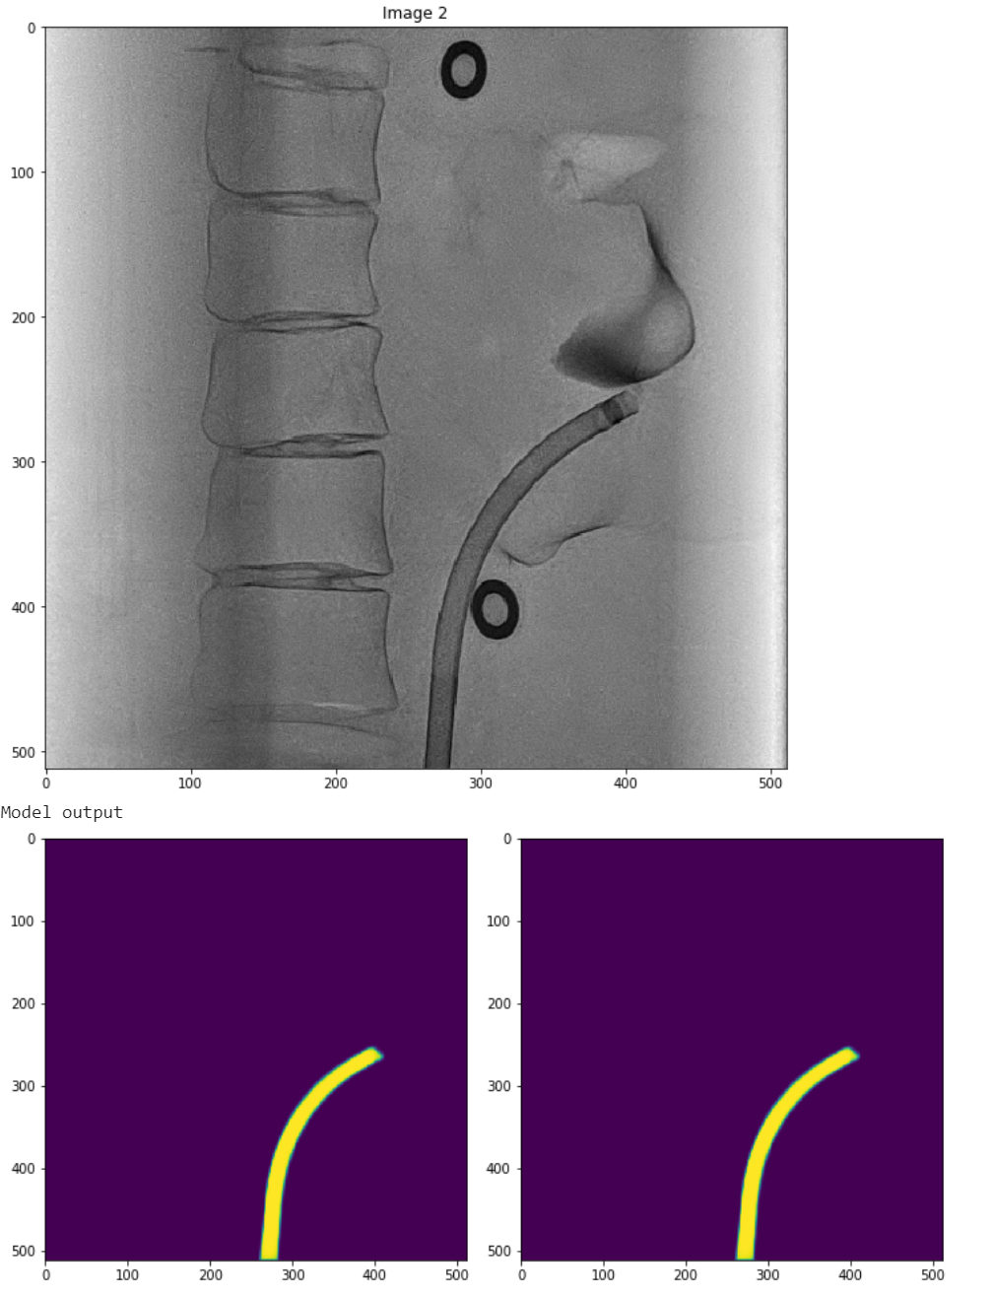
U-Net (Single Class)

Slide 4
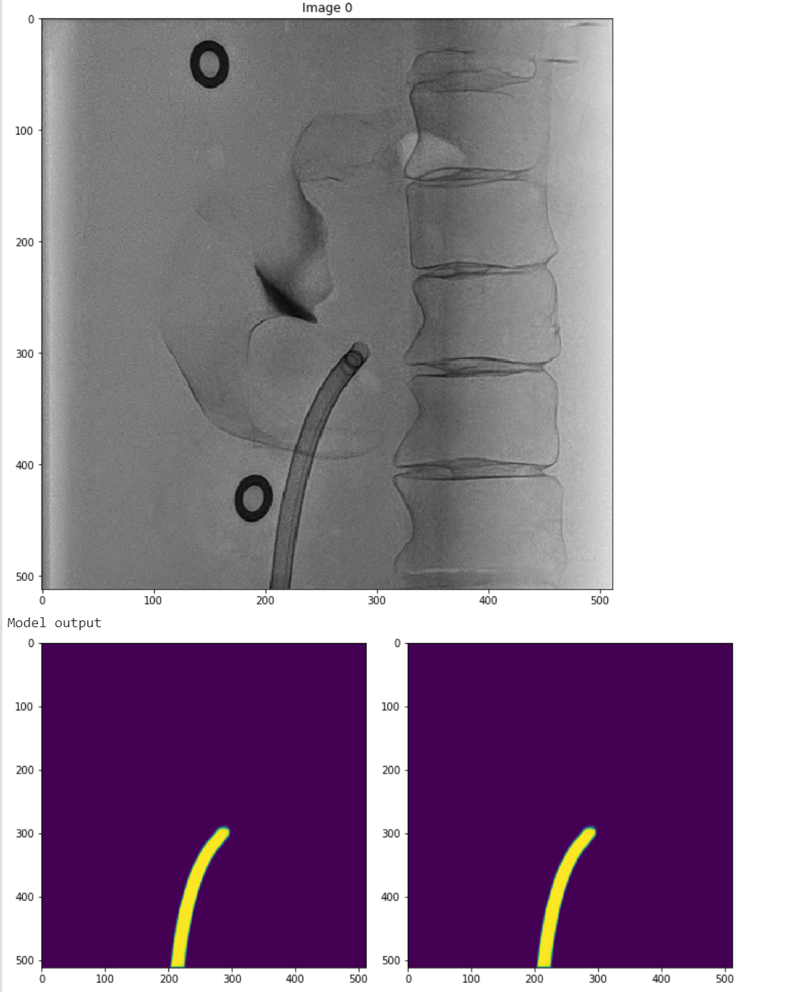
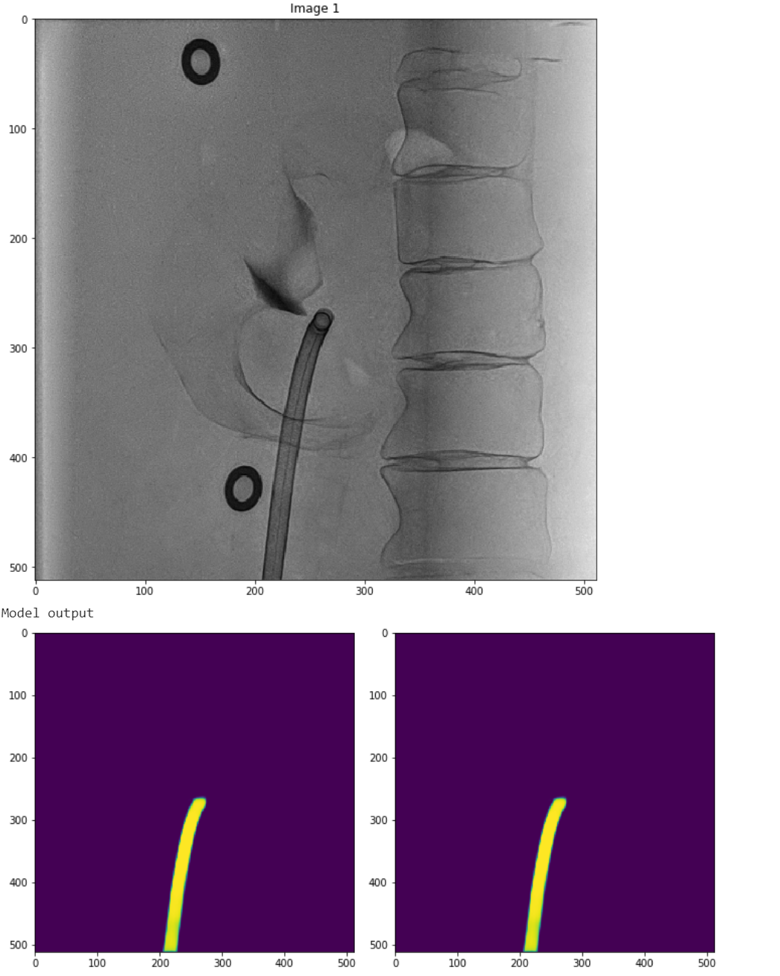
U-Net (Single Class) cont.

Slide 5
U-Net Details
Current Training Set:
Resolution: 512x512
240 Images with 80%/20% train/test split
Trained for 40 epochs
U-Net with the given images can detect the catheter successfully.
It seems to me that the dataset currently used for spine detection isn’t as visually clear as these images for U-Net.
We should try to run this model a couple more times with that dataset if there is one involving a catheter to ensure this catheter model is robust enough for more “visually challenging” scenarios.

Slide 6
Spine Detection

Slide 7
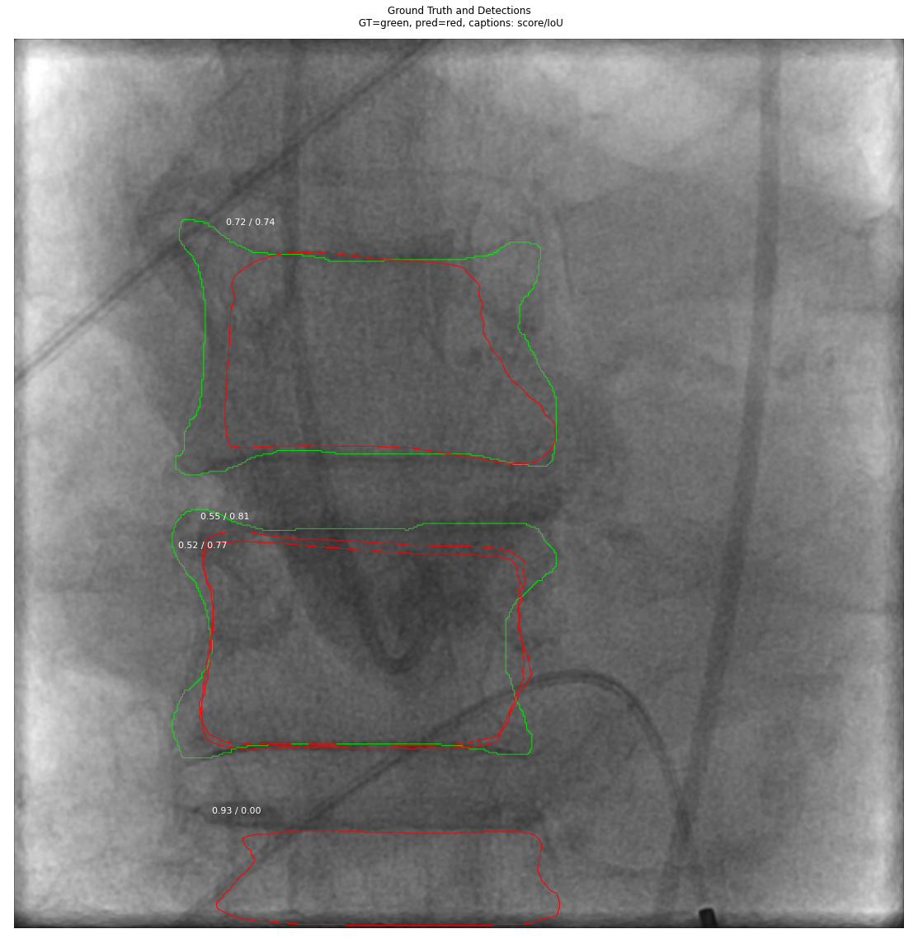
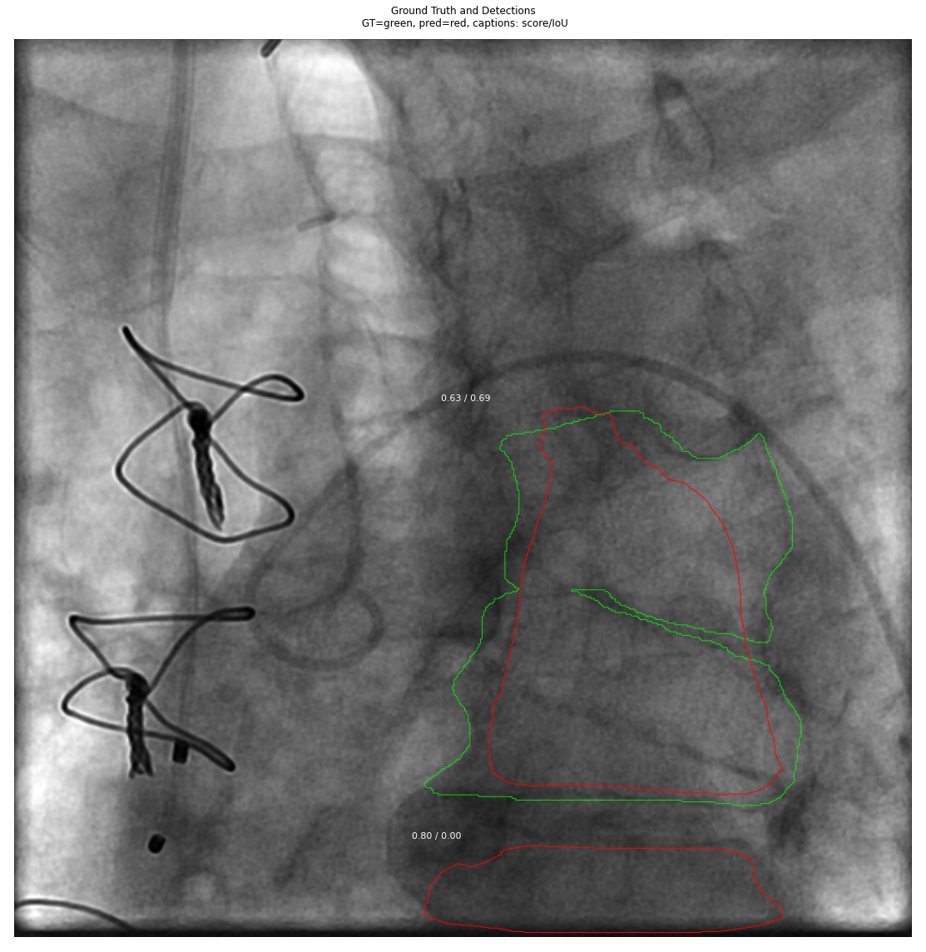
Mask-RCNN (Multi-Class)

Slide 8
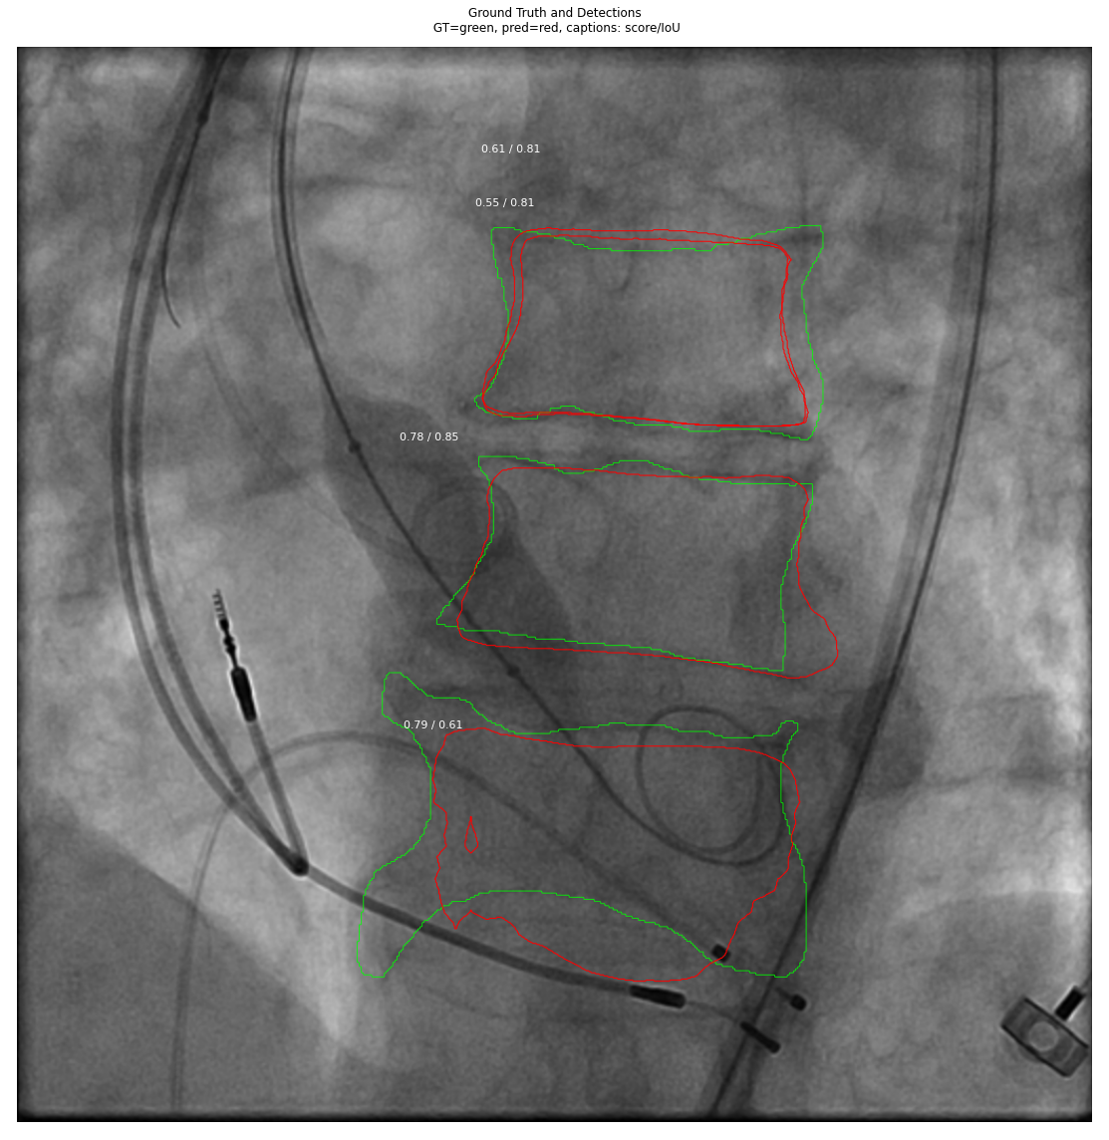
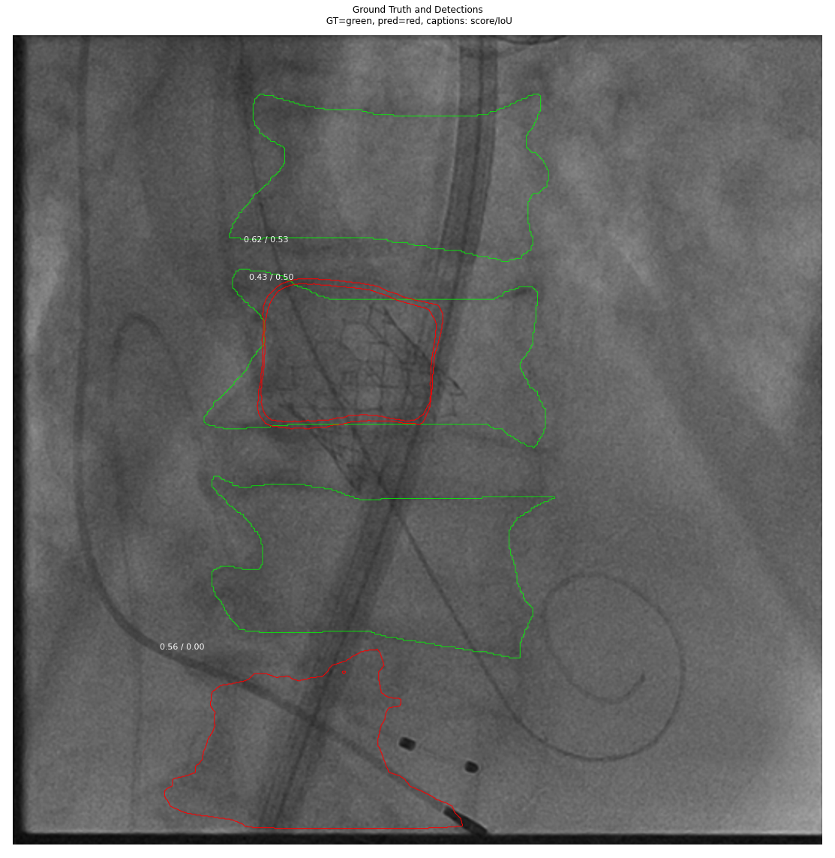
Mask-RCNN (Multi-Class)

Slide 9
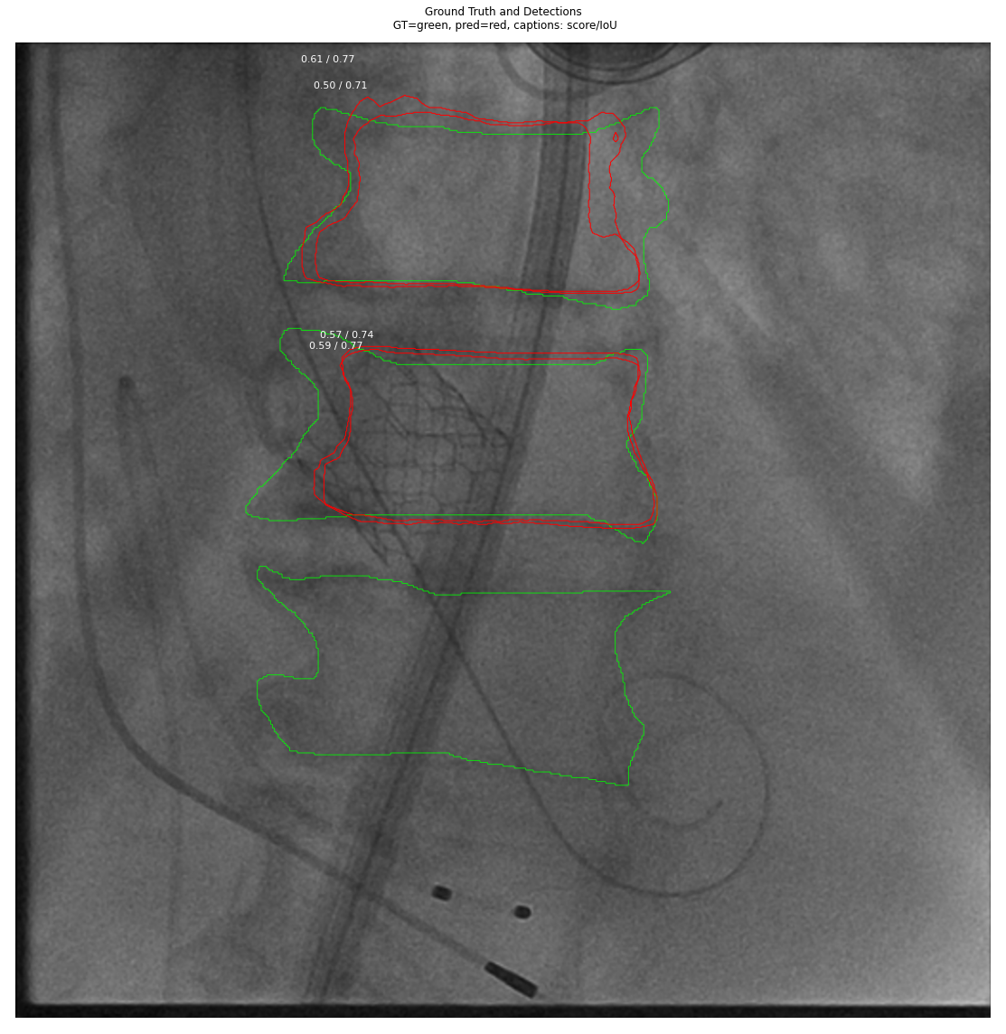
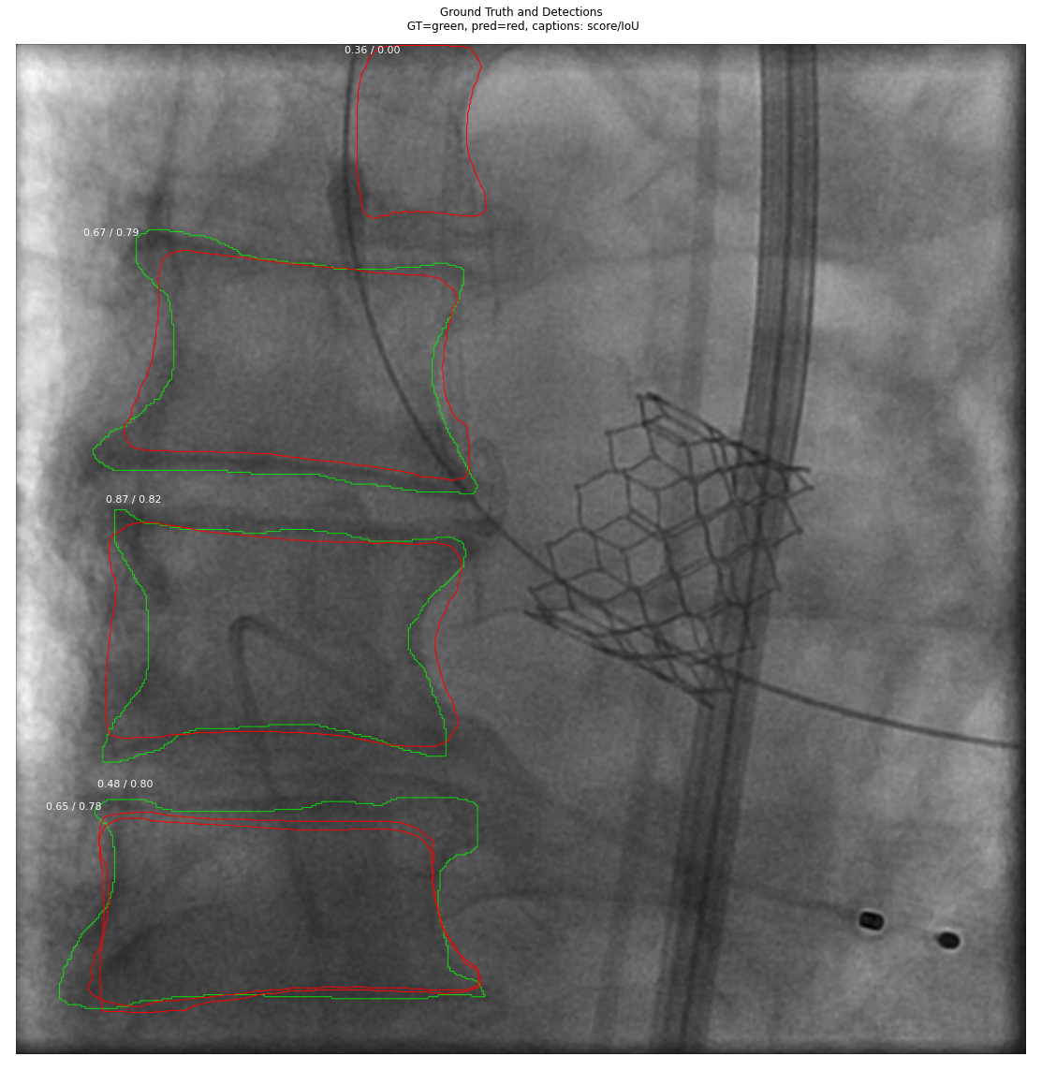
Mask-RCNN (Multi-Class)

Slide 10
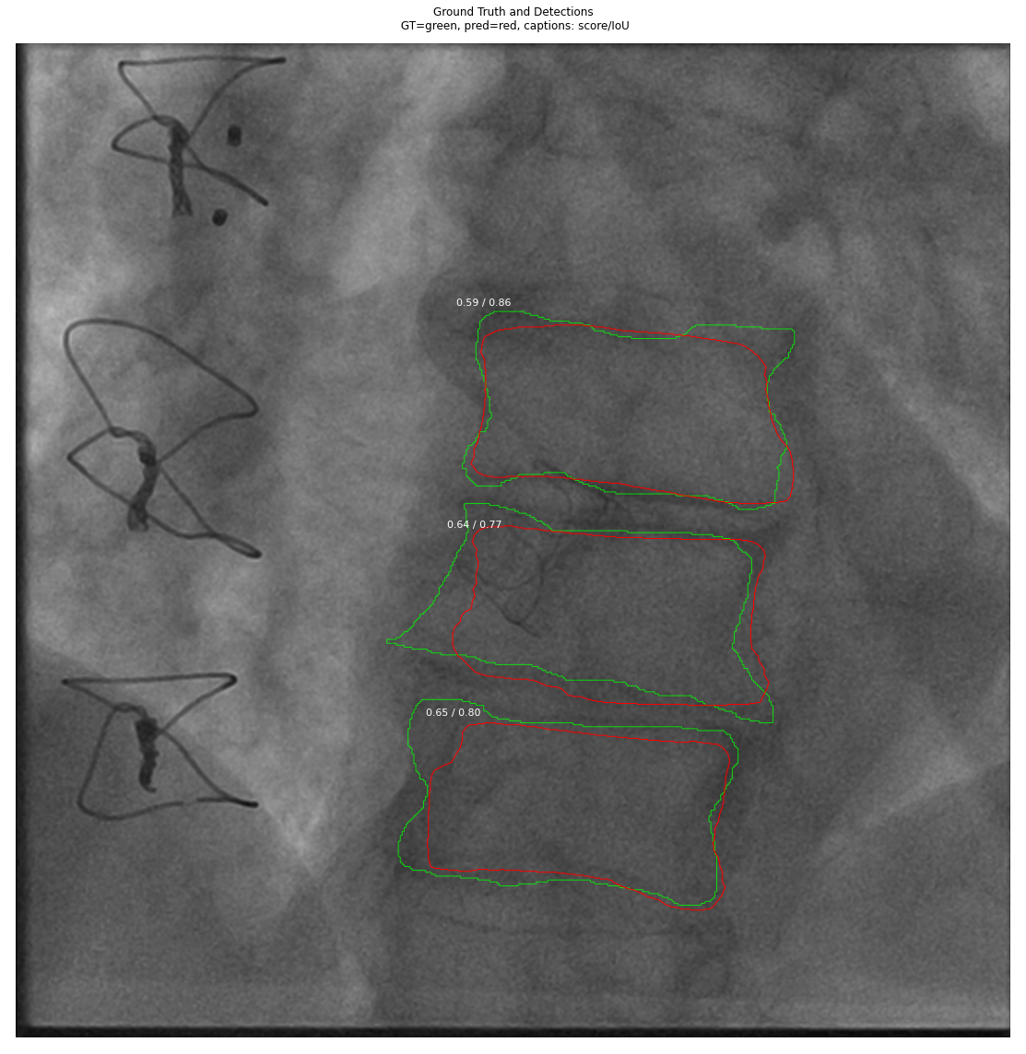
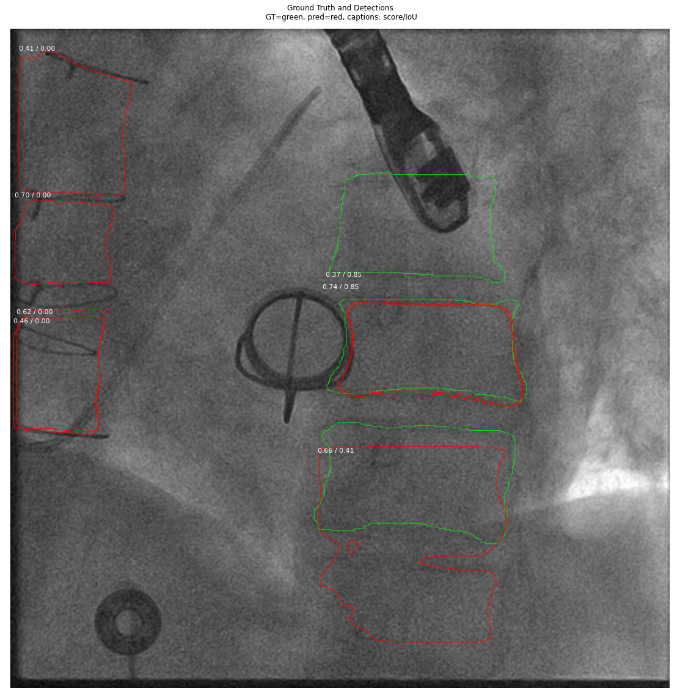
Mask-RCNN (Multi-Class)

Slide 11
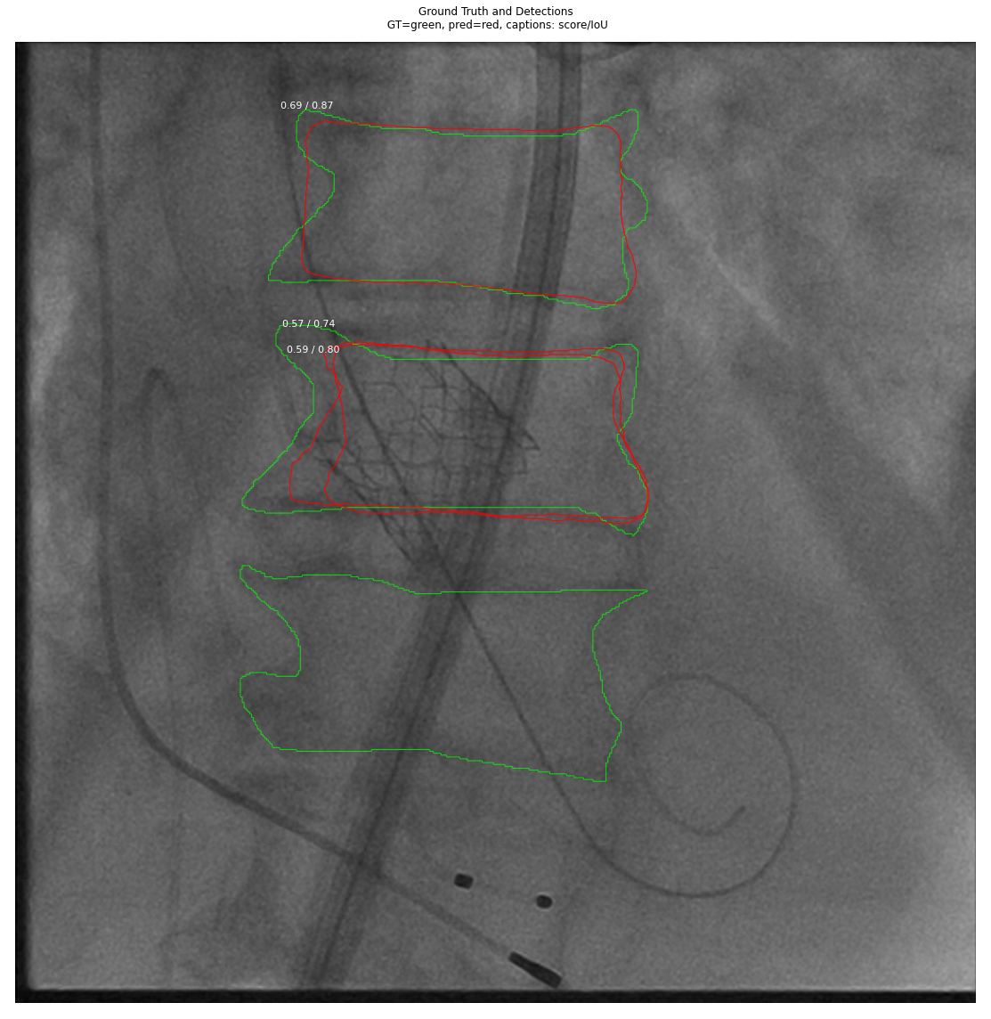
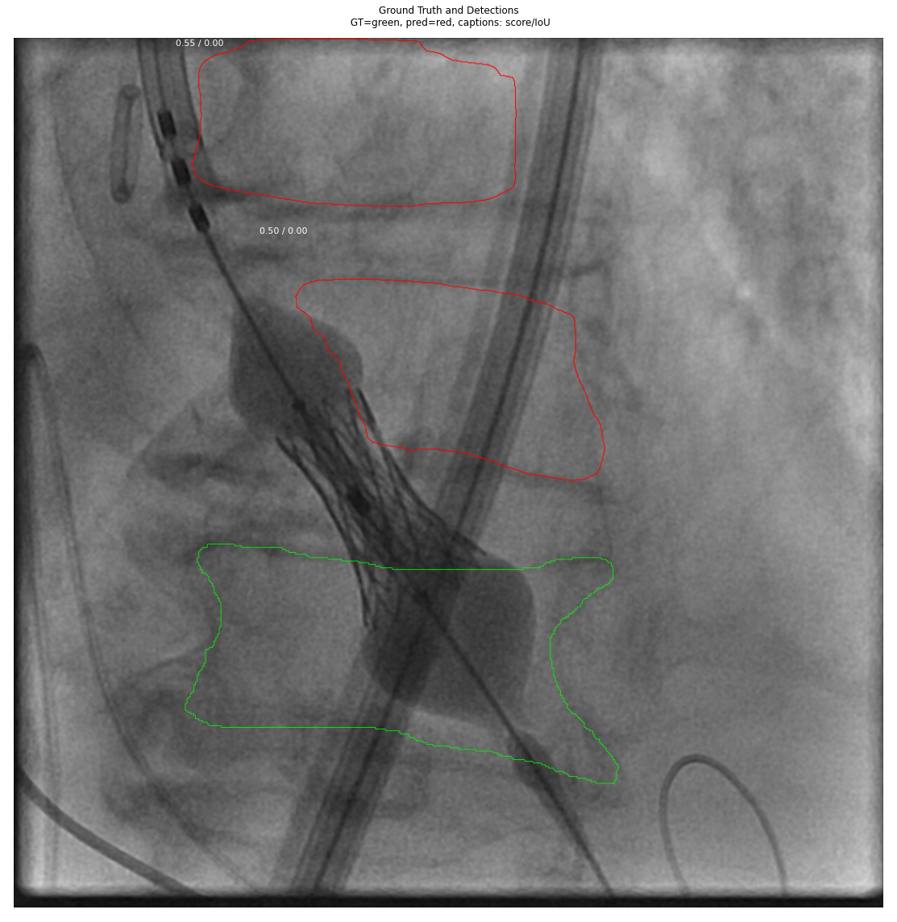
Mask-RCNN (Multi-Class)

Slide 12
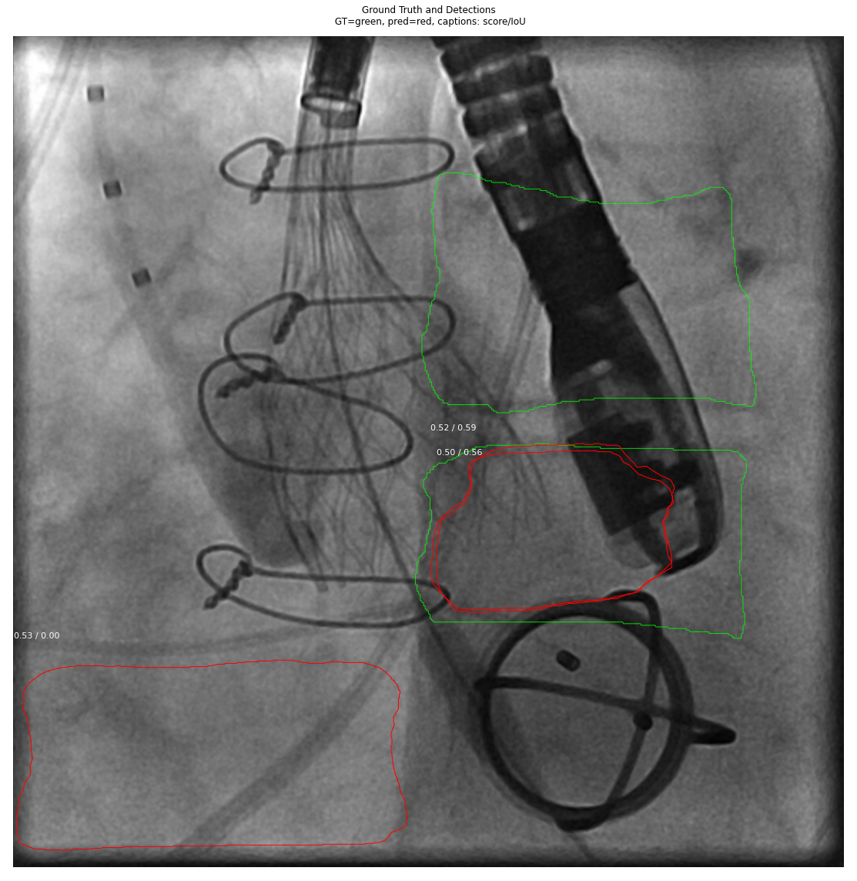
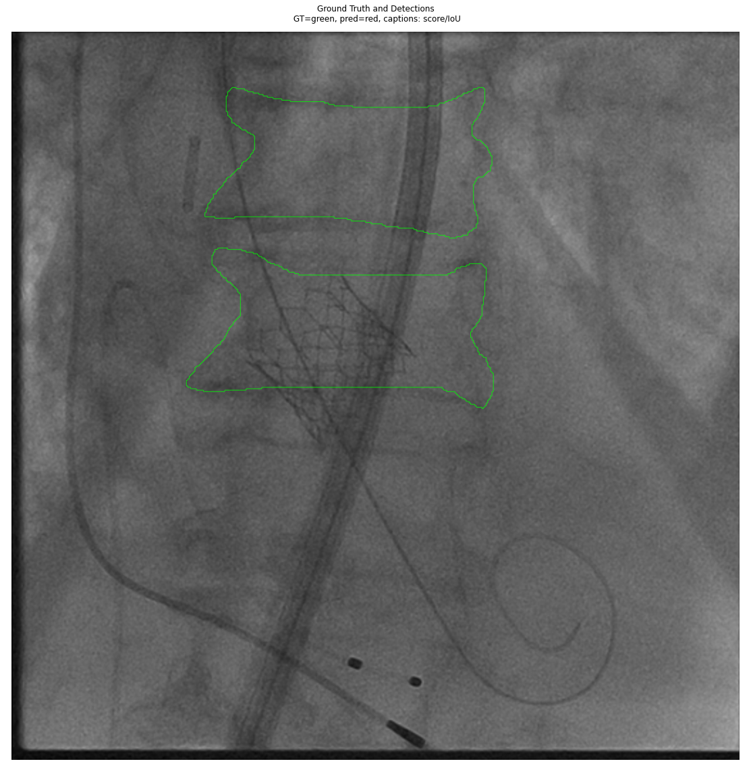
Mask-RCNN (Multi-Class)

Slide 13
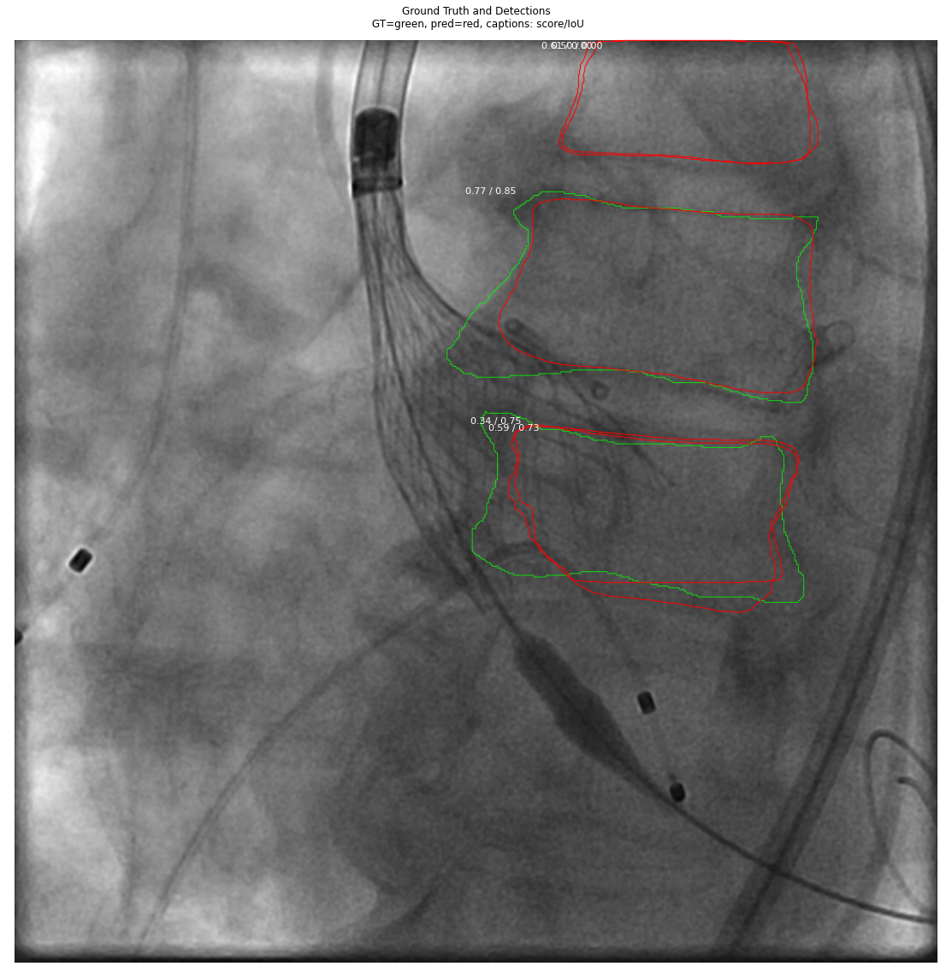

Mask-RCNN (Multi-Class)

Slide 14
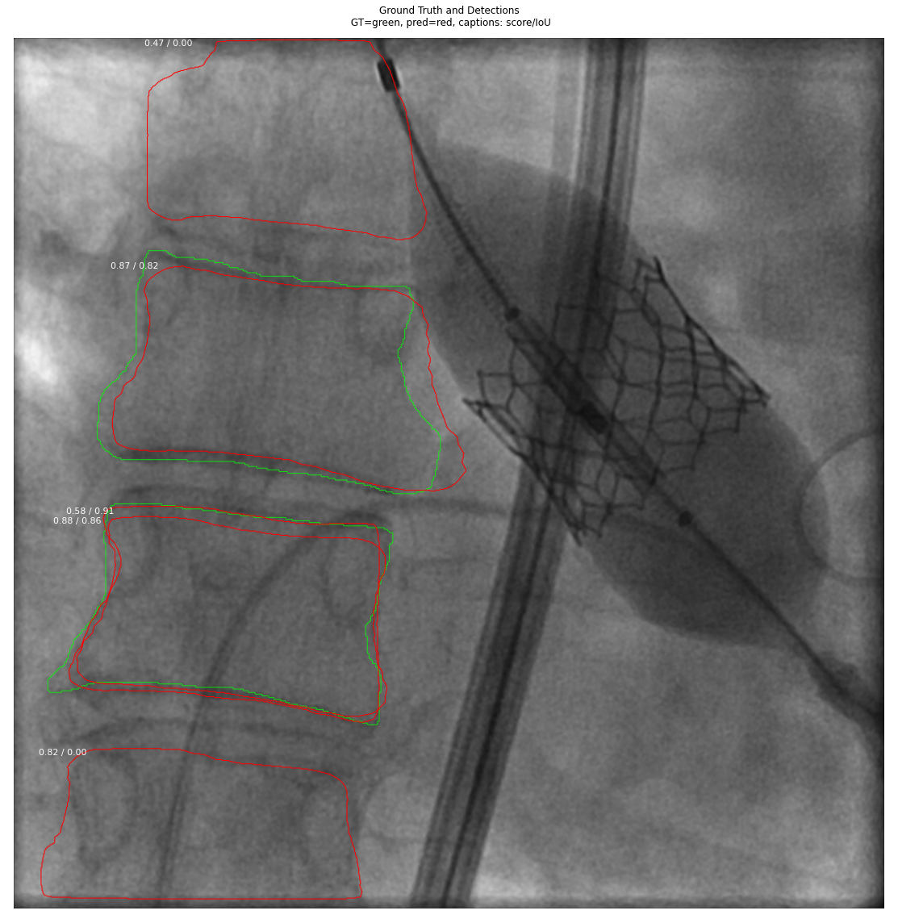
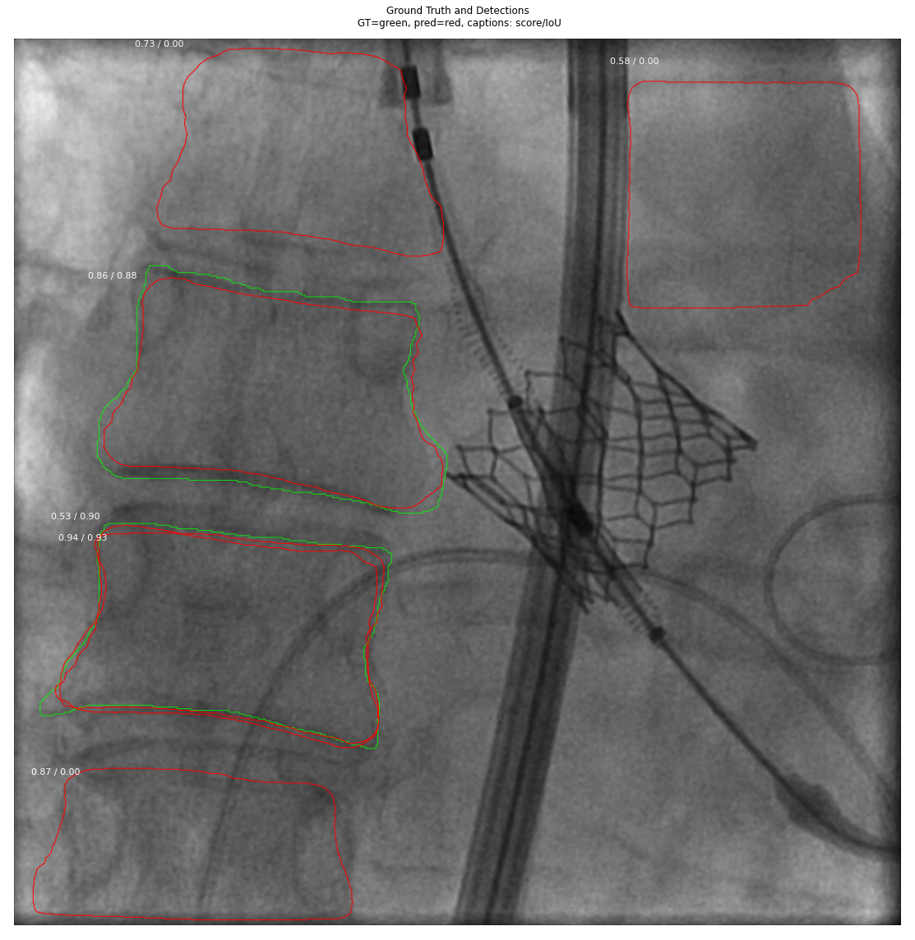
Mask-RCNN (Multi-Class)

Slide 15
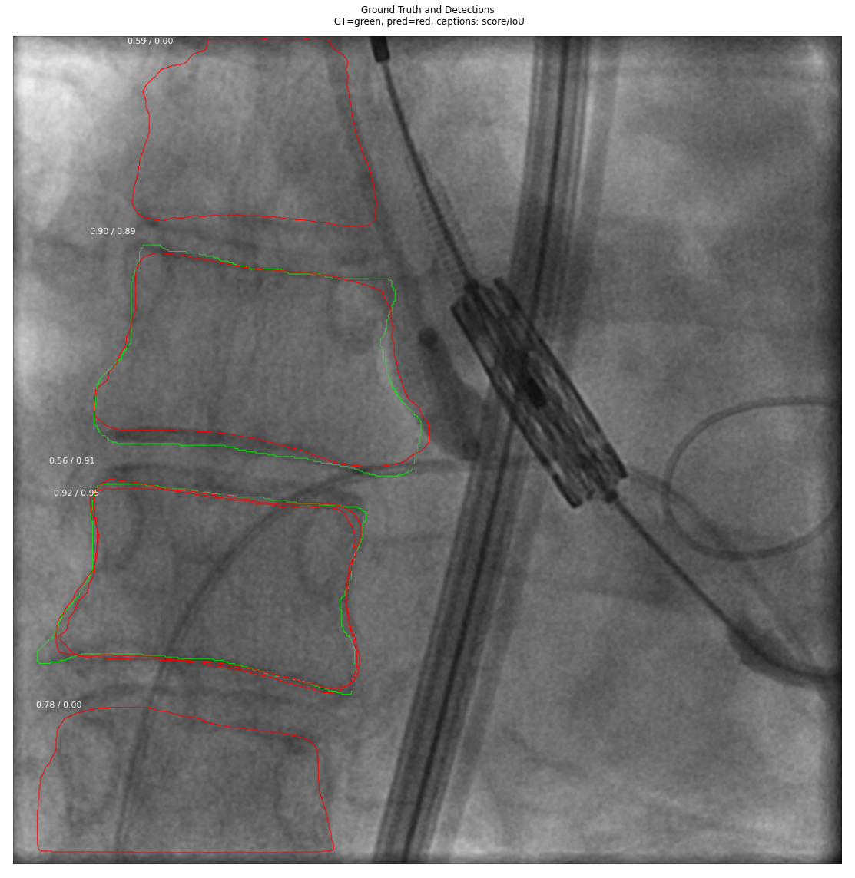
Mask-RCNN (Multi-Class)

Slide 16
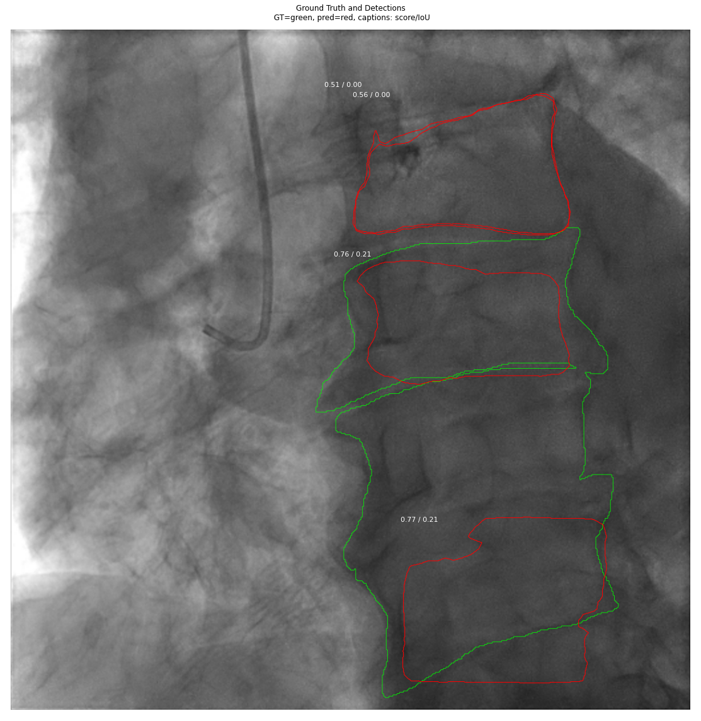
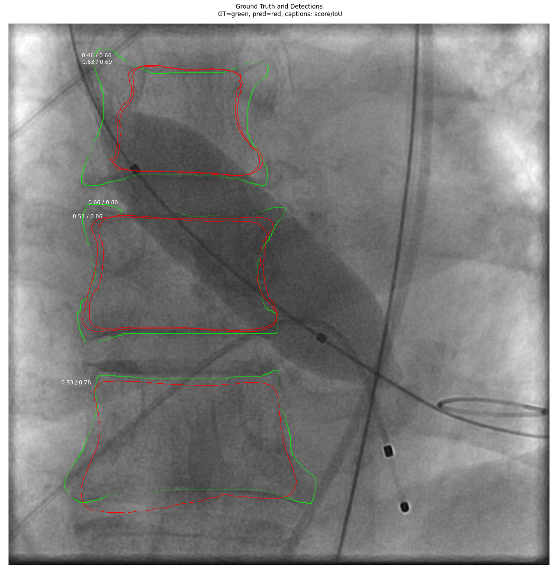
Mask-RCNN (Multi-Class)

